Slide 1

15CSE301 Computer Organization and Architecture
Assessing and Understanding Performance
Reference:
Chapter 4
Computer Organization and Design, The hardware / software interface, 3rd Edition
Dr Ganesh Neelakanta Iyer
Associate Professor, Dept of Computer Science and Engg
Amrita Vishwa Vidyapeetham, Coimbatore

Slide 2
RECAP
You have learnt MIPS architecture
Instruction set
Addressing Modes
Conversion of instructions to different formats
Single cycle and multi cycle datapath implementation

Slide 3
Performance Perspectives
Purchasing perspective
Given a collection of machines, which has the
Best performance ?
Least cost ?
Best performance / cost ?
Design perspective
Faced with design options, which has the
Best performance improvement ?
Least cost ?
Best performance / cost ?
Both require
basis for comparison
metric for evaluation
Our goal: understand cost & performance implications of architectural choices

Slide 4
Two Notions of “Performance”
Plane
DC to Paris
Speed
Passengers
Throughput (pmph)
Boeing 747
6.5 hours
610 mph
470
286,700
Concorde
3 hours
1350 mph
132
178,200
Which has higher performance?
Execution time (response time, latency, …)
Time to do a task
Throughput (bandwidth, …)
Tasks per unit of time
Response time and throughput often are in opposition

Slide 5
Definitions
Performance is typically in units-per-second
bigger is better
If we are primarily concerned with response time
performance = 1 execution_time
" X is n times faster than Y" means

Slide 6
Example
Time of Concorde vs. Boeing 747?
Concord is 1350 mph / 610 mph = 2.2 times faster
= 6.5 hours / 3 hours
Throughput of Concorde vs. Boeing 747 ?
Concord is 178,200 pmph / 286,700 pmph = 0.62 “times faster”
Boeing is 286,700 pmph / 178,200 pmph = 1.60 “times faster”
Boeing is 1.6 times (“60%”) faster in terms of throughput
Concord is 2.2 times (“120%”) faster in terms of flying time
We will focus primarily on execution time for a single job
Lots of instructions in a program => Instruction throughput important!

Slide 7
Metrics of Performance
Seconds per program
Useful Operations per second
Application
Programming
Language
Compiler
(millions) of Instructions per second – MIPS
(millions) of (F.P.) operations per second – MFLOP/s
ISA
Datapath
Control
Megabytes per second
Function Units
Transistors
Wires
Pins
Cycles per second (clock rate)

Slide 8
Organizational Trade-offs
Application
Programming
Language
Compiler
ISA
Instruction Mix
Datapath
Control
CPI
Function Units
Transistors
Wires
Pins
Cycle Time
CPI is a useful design measure relating the Instruction Set Architecture with the Implementation of that architecture, and the program measured

Slide 9
Processor Cycles
Clock
.
.
.
.
.
.
.
.
.
.
.
.
Combination Logic
Cycle
Most contemporary computers have fixed, repeating clock cycles
Notes:
All of you should have taken a logic design class so you should know how to do a synchronous design using a clock but let’s have a brief review.
In this class, all your designs should only have one clock in it. Furthermore, all storage elements are clocked by the same clock edge, namely the falling clock edge.
You should NOT try to use both edges of the clock nor try to use any Flip Flops that are level sensitive instead of edge sensitive. (This is reserved for real world desingers!)
If you follow this clocking methodology (All storage elements are clocked ....), then the inputs to your combinational logic blocks will come from the outputs of some registers or externally.
Consequently, they are updated at each clock tick.
On the other side of the combination logic block, the outputs will be saved in another register.
Therefore, the outputs must be stable before the next clock tick.
+2 = 63 min. (Y:43)

Slide 10
Three Components of CPU Performance
CPU time_{X,P} = Instructions executed_{P} * CPI_{X,P} * Clock cycle time_{X}
Cycles Per Instruction

Slide 11
Instructions Executed
Instructions executed:
We are not interested in the static instruction count, or how many lines of code are in a program.
Instead we care about the dynamic instruction count, or how many instructions are actually executed when the program runs.
There are three lines of code below, but the number of instructions executed would be XXXX?.
li $a0, 1000
Ostrich: sub $a0, $a0, 1
bne $a0, $0, Ostrich

Slide 12
CPI
The average number of clock cycles per instruction, or CPI, is a function of the machine and program.
The CPI depends on the actual instructions appearing in the program—a floating-point intensive application might have a higher CPI than an integer-based program.
It also depends on the CPU implementation. For example, a Pentium can execute the same instructions as an older 80486, but faster.
It is common to each instruction took one cycle, making CPI = 1.
The CPI can be >1 due to memory stalls and slow instructions.
The CPI can be <1 on machines that execute more than 1 instruction per cycle (superscalar).

Slide 13
Clock cycle time
One “cycle” is the minimum time it takes the CPU to do any work.
The clock cycle time or clock period is just the length of a cycle.
The clock rate, or frequency, is the reciprocal of the cycle time.
Generally, a higher frequency is better.
Some examples illustrate some typical frequencies.
A 500MHz processor has a cycle time of 2ns.
A 2GHz (2000MHz) CPU has a cycle time of just 0.5ns (500ps).

Slide 14
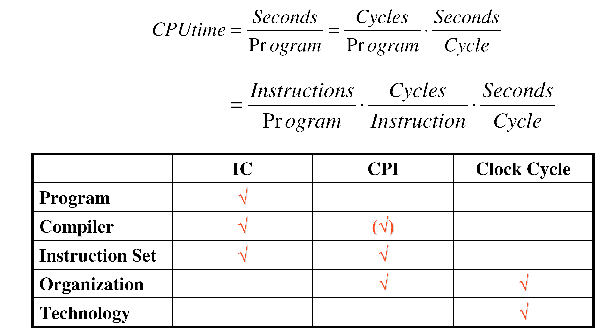
CPU Performance
CPU time_{X,P} = Instructions executed_{P} * CPI_{X,P} * Clock cycle time_{X}
CPI
Inst. Count
Cycle Time

Slide 15
Example 1
CPU clock rate is 1 MHz
Program takes 45 million cycles to execute
What’s the CPU time?

Slide 16
Example 1
CPU clock rate is 1 MHz
Program takes 45 million cycles to execute
What’s the CPU time?
45,000,000 * (1 / 1,000,000) = 45 seconds

Slide 17
Example 2
CPU clock rate is 500 MHz
Program takes 45 million cycles to execute
What’s the CPU time?

Slide 18
Example 2
CPU clock rate is 500 MHz
Program takes 45 million cycles to execute
What’s the CPU time?
45,000,000 * (1 / 500,000,000) = 0.09 seconds

Slide 19
Example 3
Let assume that a benchmark has 100 instructions:
25 instructions are loads/stores (each take 2 cycles)
50 instructions are adds (each takes 1 cycle)
25 instructions are square root (each takes 50 cycles)
What is the CPI for this benchmark?

Slide 20
Example 3
Let assume that a benchmark has 100 instructions:
25 instructions are loads/stores (each take 2 cycles)
50 instructions are adds (each takes 1 cycle)
25 instructions are square root (each takes 50 cycles)
What is the CPI for this benchmark?
CPI = ((0.25 * 2) + (0.50 * 1) + (0.25 * 50)) = 13.5

Slide 21
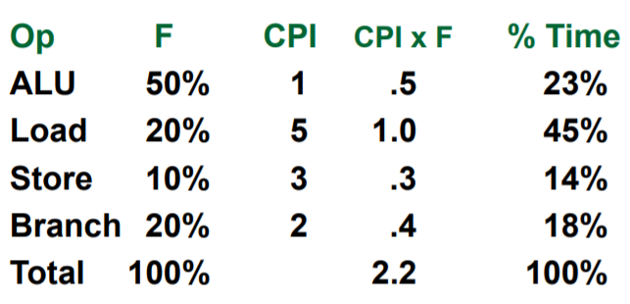
Computing CPI
The CPI is the average number of cycles per instruction
If for each instruction type, we know its frequency and number of cycles need to execute it, we can compute the overall CPI as follows
CPI = Σ CPI x F
For example

Slide 22
Cycles Per Instruction (Throughput)
“Cycles per Instruction”
CPI = (CPU Time * Clock Rate) / Instruction Count
= Cycles / Instruction Count
“Instruction Frequency”

Slide 23
Example 4
Suppose we have two implementations of the same ISA
For some program,
Machine A has a clock cycle time of 10 ns. and a CPI of 2.0
Machine B has a clock cycle time of 20 ns. and a CPI of 1.2
Which machine is faster for this program, and by how much?
Assume that # of instructions in the program is 1,000,000,000

Slide 24
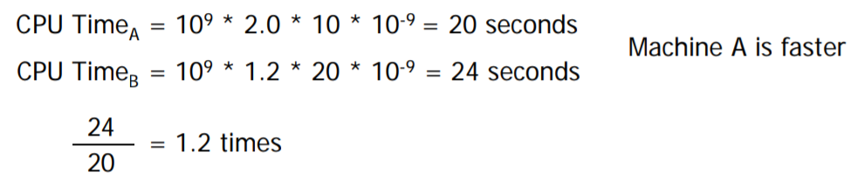
Example 4
Suppose we have two implementations of the same ISA
For some program,
Machine A has a clock cycle time of 10 ns. and a CPI of 2.0
Machine B has a clock cycle time of 20 ns. and a CPI of 1.2
Which machine is faster for this program, and by how much?
Assume that # of instructions in the program is 1,000,000,000

Slide 25
Principal Design Metrics: CPI and Cycle Time

Slide 26
Example
Typical Mix
Op Freq Cycles CPI
ALU 50% 1 .5
Load 20% 5 1.0
Store 10% 3 .3
Branch 20% 2 .4
2.2
How much faster would the machine be if a better data cache reduced the average load time to 2 cycles?
Load → 20% x 2 cycles = .4
Total CPI 2.2 → 1.6
Relative performance is 2.2 / 1.6 = 1.38
How does this compare with reducing the branch instruction to 1 cycle?
Branch → 20% x 1 cycle = .2
Total CPI 2.2 → 2.0
Relative performance is 2.2 / 2.0 = 1.1

Slide 27
Example 5
A compiler designer is trying to decide between two code sequences for a particular machine. Based on the hardware implementation, there are three different classes of instructions: Class A, Class B, and Class C, and they require one, two, and three cycles (respectively)
The first code sequence has 5 instructions: 2 of A, 1 of B, and 2 of C
The second sequence has 6 instructions: 4 of A, 1 of B, and 1 of C
Which sequence will be faster? How much?
What is the CPI for each sequence?

Slide 28
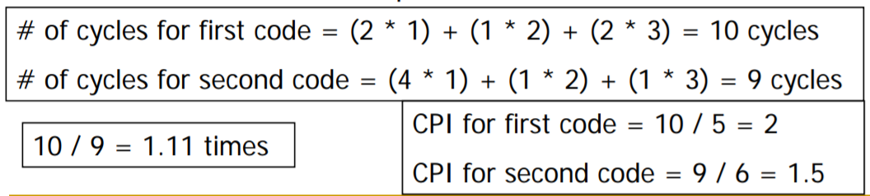
Example 5
A compiler designer is trying to decide between two code sequences for a particular machine. Based on the hardware implementation, there are three different classes of instructions: Class A, Class B, and Class C, and they require one, two, and three cycles (respectively)
The first code sequence has 5 instructions: 2 of A, 1 of B, and 2 of C
The second sequence has 6 instructions: 4 of A, 1 of B, and 1 of C
Which sequence will be faster? How much?
What is the CPI for each sequence?

Slide 29
Summary: Evaluating Instruction Sets and Implementation
Design-time metrics:
Can it be implemented, in how long, at what cost?
Can it be programmed? Ease of compilation?
Static Metrics:
How many bytes does the program occupy in memory?
Dynamic Metrics:
How many instructions are executed?
How many bytes does the processor fetch to execute the program?
How many clocks are required per instruction?
How "lean" a clock is practical?
Best Metric: Time to execute the program!
CPI
NOTE: Depends on instructions set, processor organization, and compilation techniques.
Inst. Count
Cycle Time

Slide 30
Amdahl’s Law
Amdahl’s Law states that optimizations are limited in their effectiveness.
For example, doubling the speed of floating-point operations sounds like a great idea. But if only 10% of the program execution time T involves floating-point code, then the overall performance improves by just 5%.
What is the maximum speedup from improving floating point?
Execution time after improvement | = | Time affected by improvement | + | Time unaffected by improvement
 |  | Amount of improvement
Execution time after improvement | = | 0.10 T | + | 0.90 T | = | 0.95 T
 |  | 2
Second Law of Performance:
Make the fast case common

Slide 31
Example 6
Assume that a program runs in 100 seconds on a machine, with multiply operations responsible for 80 seconds. How much do I have to improve the speed of multiplication if I want my program to run 2 times faster?

Slide 32
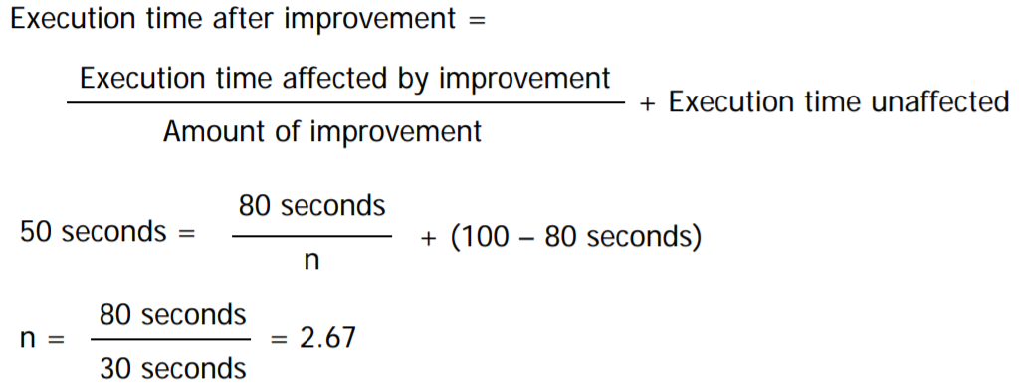
Example 6
Assume that a program runs in 100 seconds on a machine, with multiply operations responsible for 80 seconds. How much do I have to improve the speed of multiplication if I want my program to run 2 times faster?

Slide 33
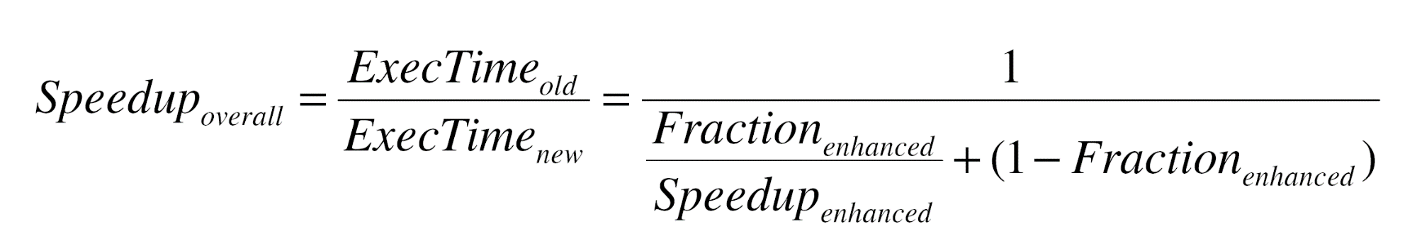
Amdahl's “Law”: Make the Common Case Fast
Speedup due to enhancement E:
ExTime w/o E Performance w/ E
Speedup(E) = -------------------- = ---------------------
ExTime w/ E Performance w/o E
Suppose that enhancement E accelerates a fraction F of the task
by a factor S and the remainder of the task is unaffected then,
ExTime(with E) = ((1-F) + F/S) X ExTime(without E)
Speedup(with E) = ExTime(without E) ÷ ((1-F) + F/S) X ExTime(without E)
Performance improvement is limited by how much the improved feature is used → Invest resources where time is spent.

Slide 34
Example 7
Floating point instructions are improved to run twice as fast, but only 10% of the time was spent on these instructions originally. How much faster is the new machine?

Slide 35
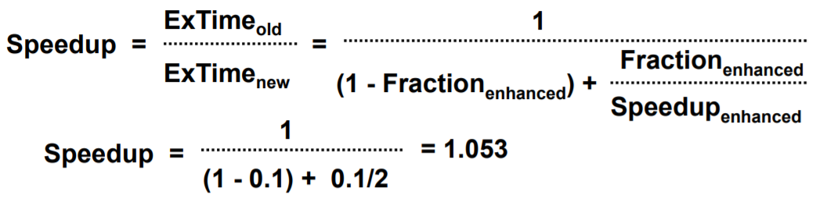
Example 7
Floating point instructions are improved to run twice as fast, but only 10% of the time was spent on these instructions originally. How much faster is the new machine?
The new machine is 1.053 times as fast, or 5.3% faster

Slide 36
Example 8
Computers M1 and M2 are two implementations of the same instruction set
M1 has a clock rate of 50 MHz and M2 has a clock rate of 100 MHz
M1 has a CPI of 2.8 and M2 has a CPI of 3.2 for a given program
How many times faster is M2 than M1 for this program?

Slide 37
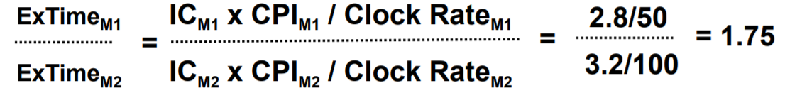
Example 8
Computers M1 and M2 are two implementations of the same instruction set
M1 has a clock rate of 50 MHz and M2 has a clock rate of 100 MHz
M1 has a CPI of 2.8 and M2 has a CPI of 3.2 for a given program
How many times faster is M2 than M1 for this program?

Slide 38
Example 9
Computers M1 and M2 are two implementations of the same instruction set
M1 has a clock rate of 50 MHz and M2 has a clock rate of 100 MHz
M1 has a CPI of 2.8 and M2 has a CPI of 3.2 for a given program
How many times faster is M2 than M1 for this program?
What would the clock rate of M1 have to be for them to have the same execution time?

Slide 39
Example 9
Computers M1 and M2 are two implementations of the same instruction set
M1 has a clock rate of 50 MHz and M2 has a clock rate of 100 MHz
M1 has a CPI of 2.8 and M2 has a CPI of 3.2 for a given program
How many times faster is M2 than M1 for this program?
What would the clock rate of M1 have to be for them to have the same execution time?
2.8 / Clock RateM1 = 3.2 / 100 Clock RateM1 = 87.5 MHz

Slide 40
Marketing Metrics
MIPS = Instruction Count / Time * 10^6 = Clock Rate / CPI * 10^6
machines with different instruction sets ?
programs with different instruction mixes ?
dynamic frequency of instructions
uncorrelated with performance
MFLOP/s= FP Operations / Time * 10^6
machine dependent
often not where time is spent

Slide 41
Summary
CPU time = Seconds = Instructions x Cycles x Seconds
Program Program Instruction Cycle
Time is the measure of computer performance!
Good products created when have:
Good benchmarks
Good ways to summarize performance
If not good benchmarks and summary, then choice between improving product for real programs vs. improving product to get more sales → sales almost always wins
Remember Amdahl’s Law: Speedup is limited by unimproved part of program

Slide 42
Additional Problems
Problems Credit: Ms Archana Devi R

Slide 43
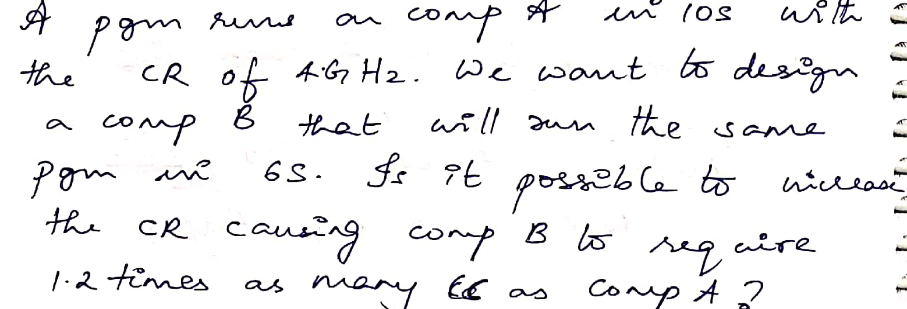
Problem 10

Slide 44
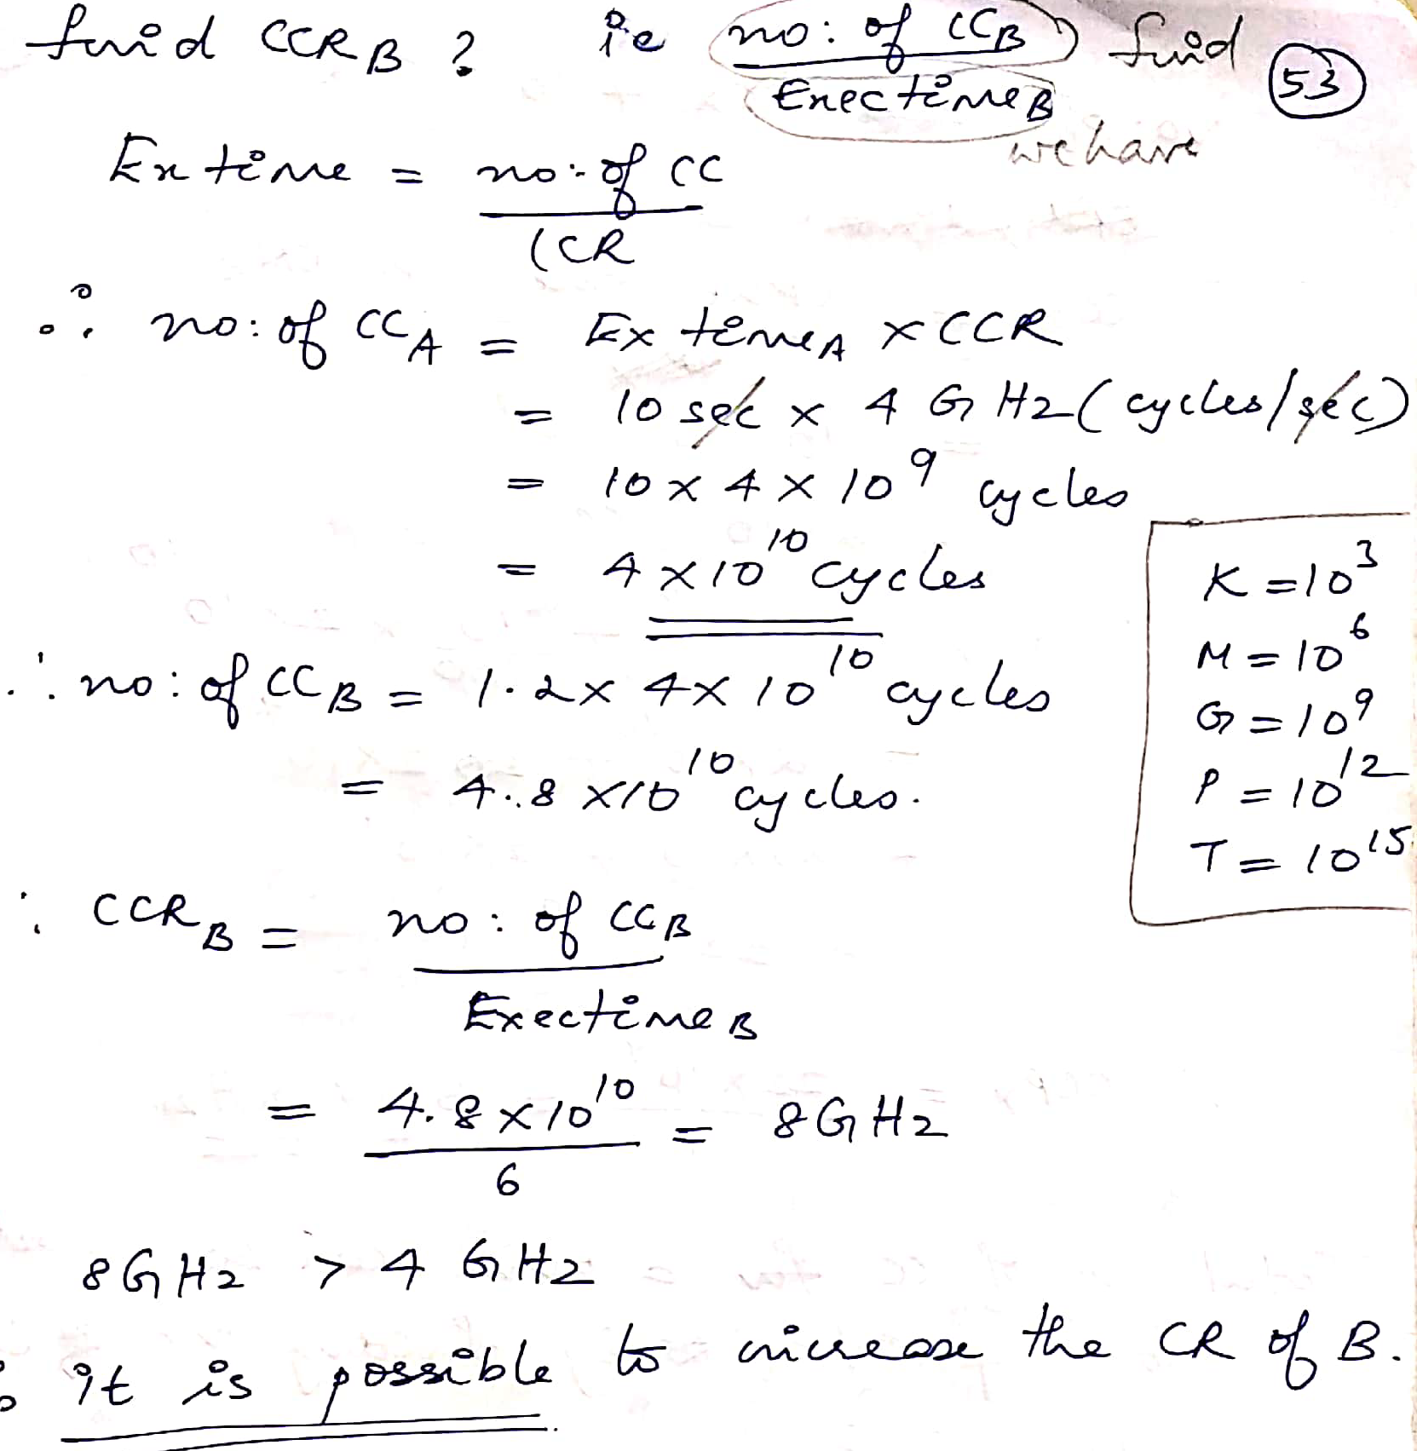
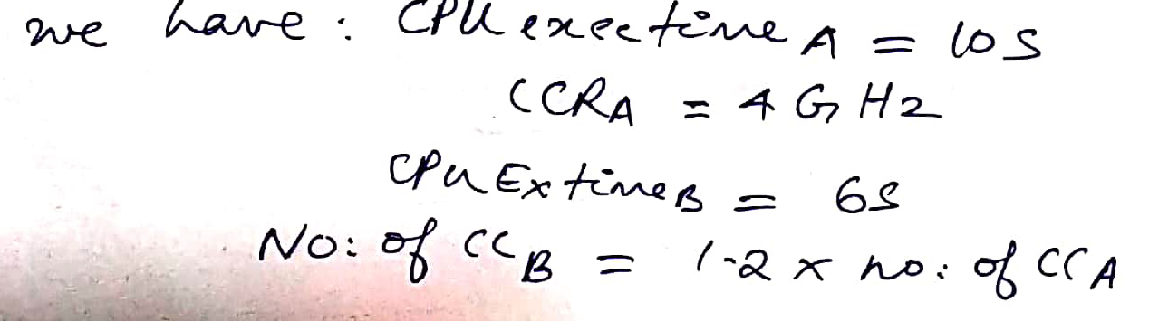
Answer 10

Slide 45
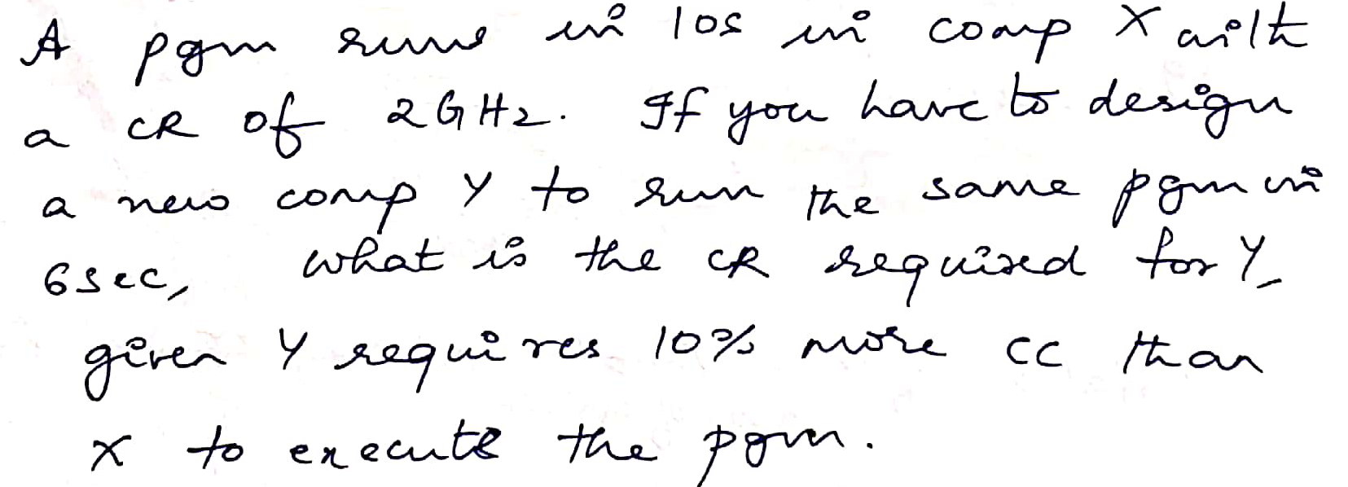
Problem 11

Slide 46
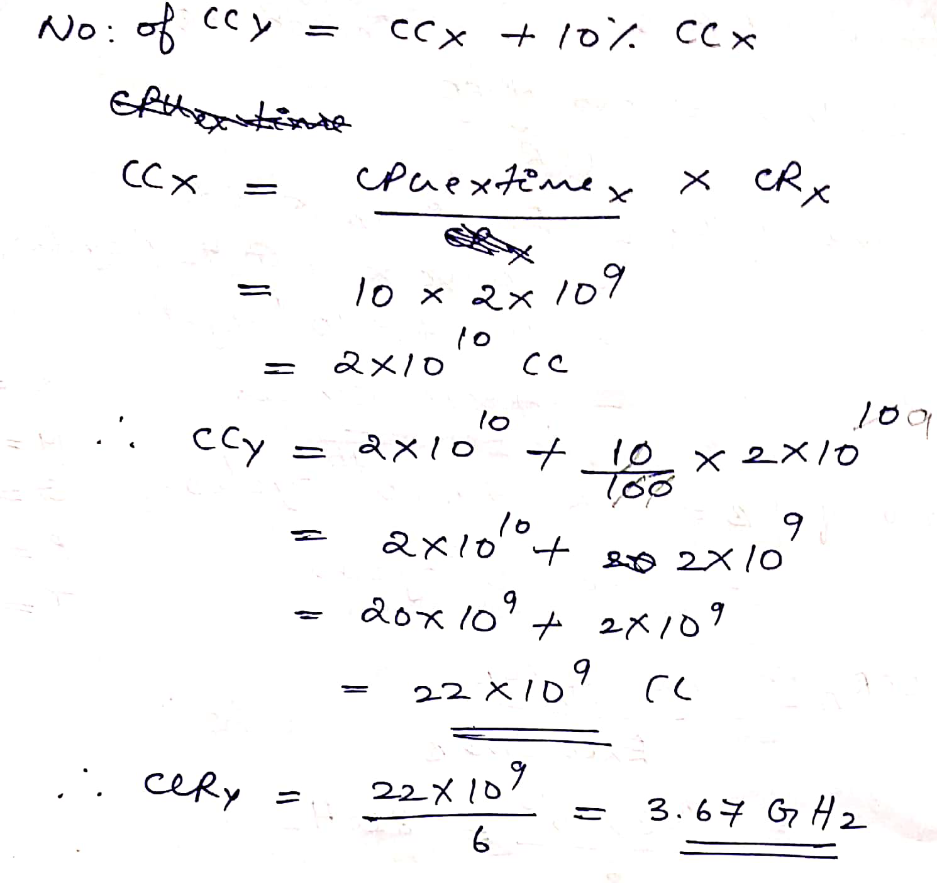
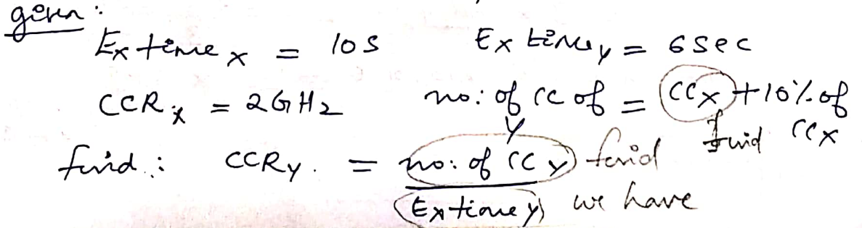
Solution 11

Slide 47
Problem 12

Slide 48
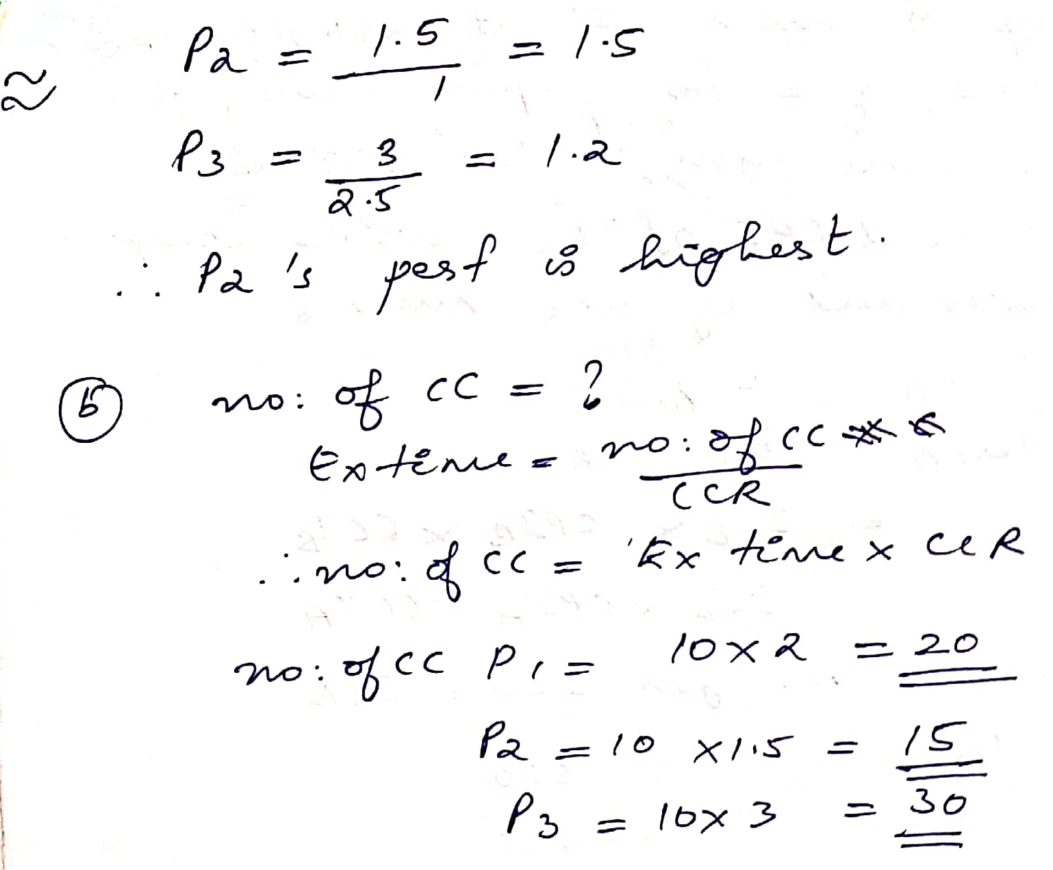
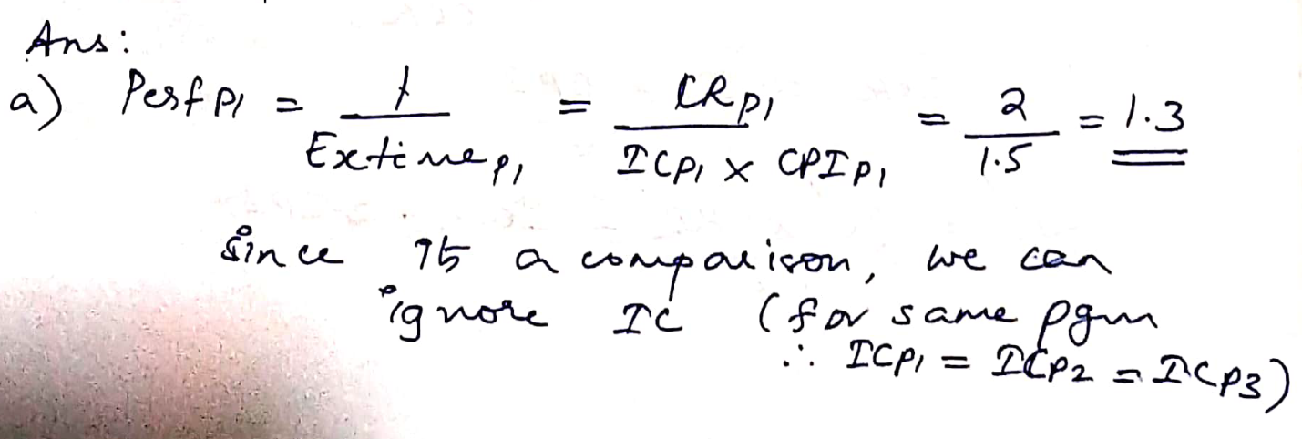
Solution 12

Slide 49
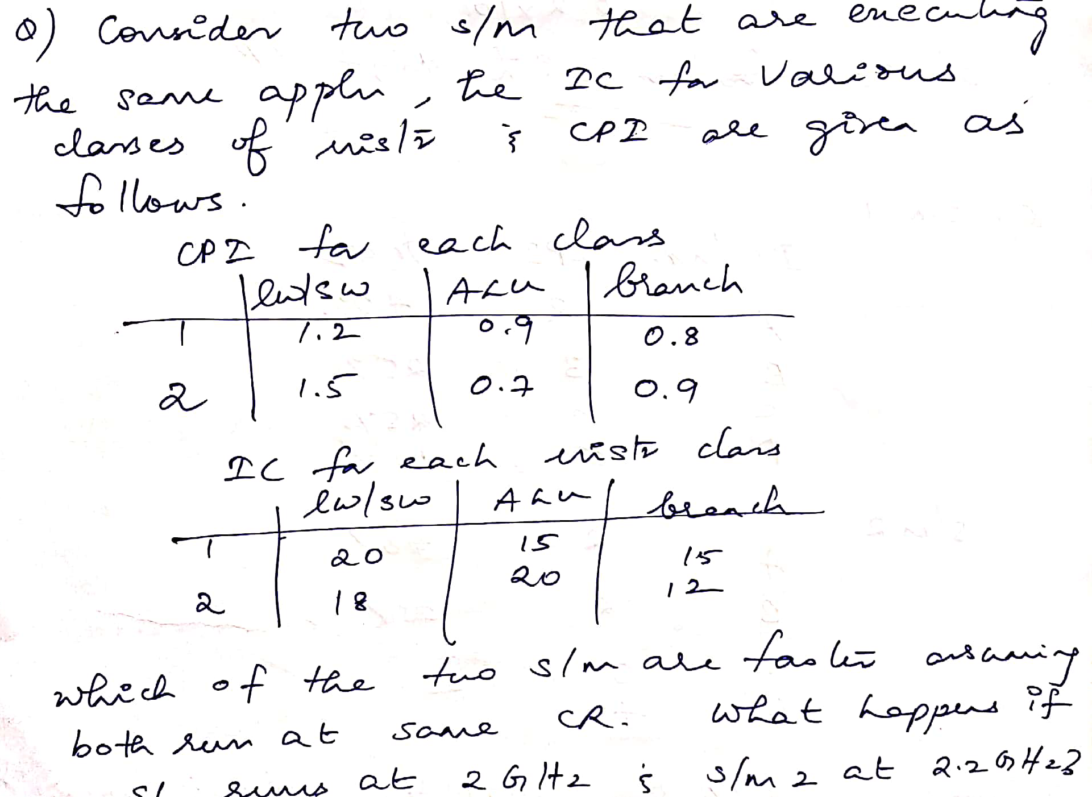
Problem 13

Slide 50
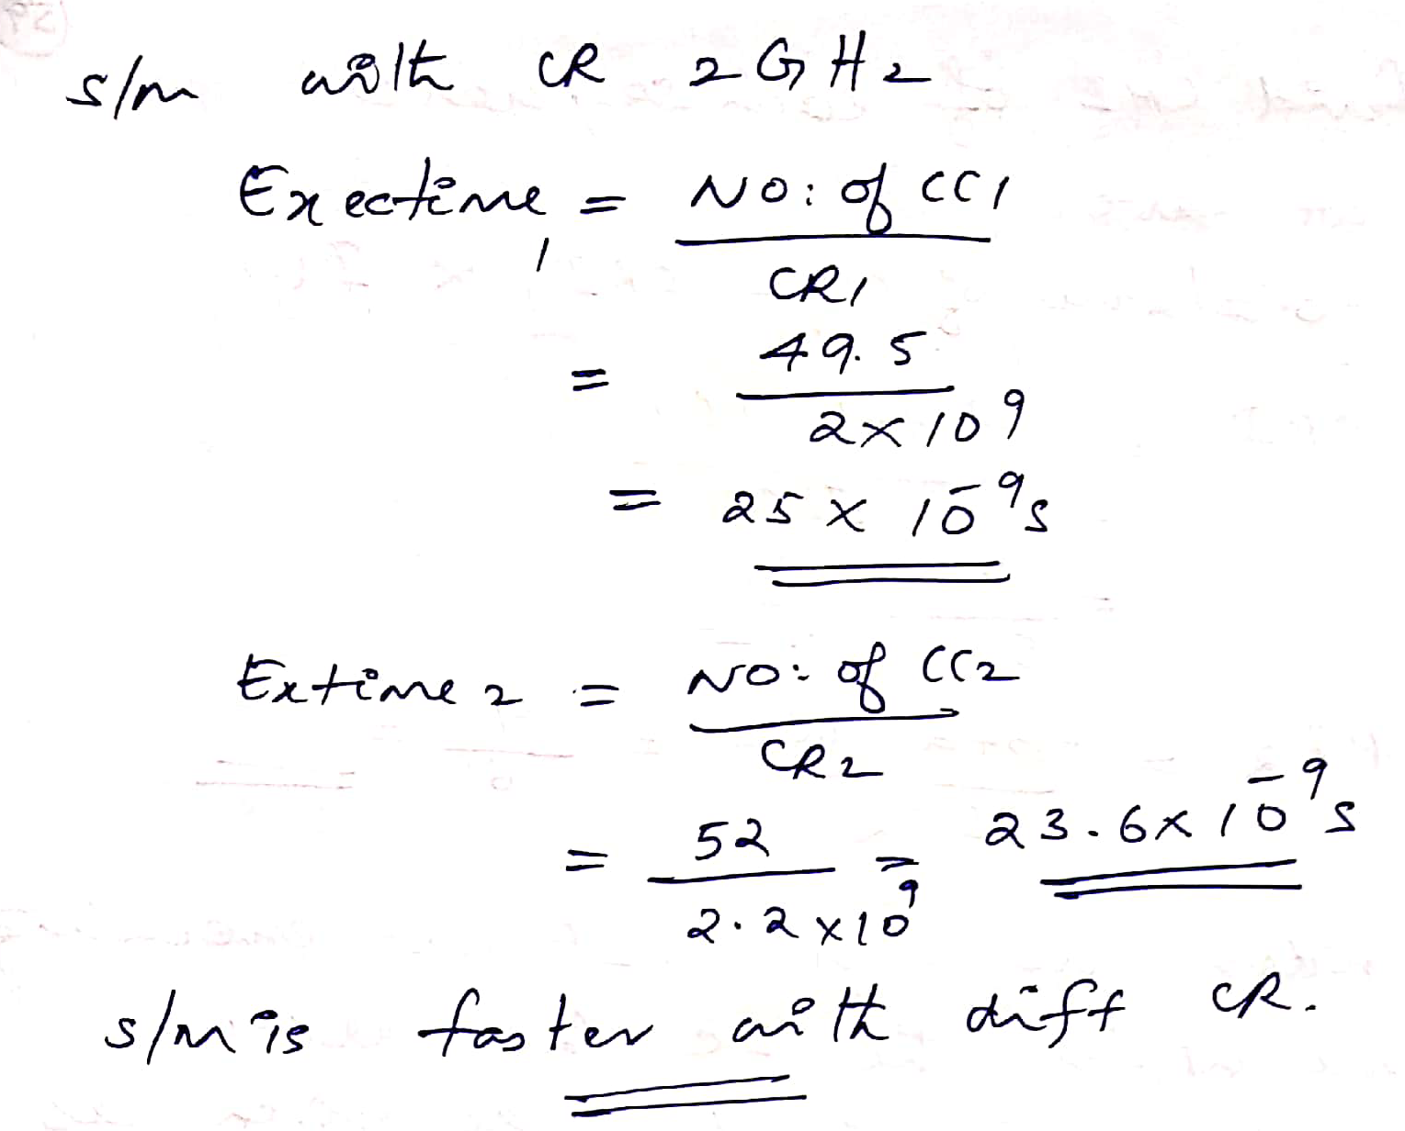
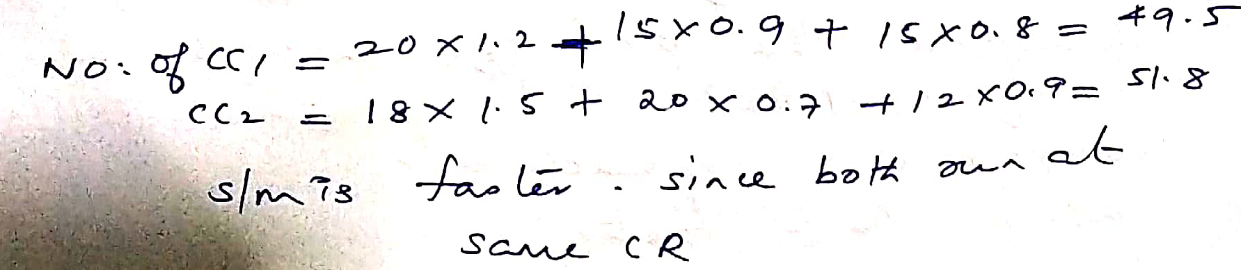
Sol 13

Slide 51
Problem 14
Assume that the operation times for the major functional units in this implementation are the following: Memory units: 200 picoseconds (ps)
ALU and adders: 100 ps
Register file (read or write):o 50 ps
Assuming that the multiplexors, control unit, PC accesses, sign extension unit, and wires have no delay, which of the following implementations would be faster and by how much?
An implementation in which every instruction operates in 1 clock cycle of a fixed length using critical path
An implementation where every instruction executes in 1 clock cycle using a variable length clock, which for each instruction is only as long as it needs to be.
To compare the performance, assume the following instruction mix: 25% loads, 10% stores, 45% ALU instructions, 15% branches, and 5% jumps.

Slide 52
Solution 14
Let's start by comparing the CPU execution times that
CPU execution time = Instruction count × CPI × Clock cycle timeSince CPI must be 1, we can simplify this to
CPU execution time = Instruction count × Clock cycle time
We need only find the clock cycle time for the two implementations, since the instruction count and CPI are the same for both implementations.
The critical path for the different instruction classes is as follows:
Instruction class | Functional units used by the instuction class
R-type | Instruction fetch | Register access | ALU | Register access
Load word | Instruction fetch | Register access | ALU | Memory access | Register access
Store word | Instruction fetch | Register access | ALU | Memory access
Branch | Instruction fetch | Register access | ALU
Jump | Instruction fetch

Slide 53
Solution 14
Using these critical paths, we can compute the required length for each instruction class:
Instruction class | Instruction memory | Register read | ALU operation | Data memory | Register write | Total
R-type | 200 | 50 | 100 | 0 | 50 | 400 ps
Load word | 200 | 50 | 100 | 200 | 50 | 600 ps
Store word | 200 | 50 | 100 | 200 |  | 550 ps
Branch | 200 | 50 | 100 | 0 |  | 350 ps
Jump | 200 |  |  |  |  | 200 ps
The clock cycle for a machine with a single clock for all instructions will be determined by the longest instruction, which is 600 ps
Thus, the average time per instruction with a variable clock is
CPU clock cycle = 600 × 25% + 550 × 10% + 400 × 45% + 350 × 15% + 200 × 5% = 447.5 ps

Slide 54
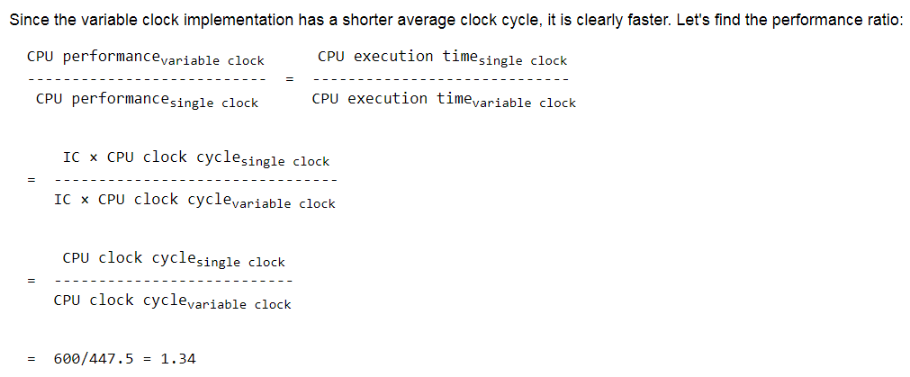
Solution 14
The variable clock implementation would be 1.34 times faster. Unfortunately, implementing a variable-speed clock for each instruction class is extremely difficult, and the overhead for such an approach could be larger than any advantage gained. As we will see in the next section, an alternative is to use a shorter clock cycle that does less work and then vary the number of clock cycles for the different instruction classes.

